Slide 1
Arterial blood pressure measurement artifacts

Slide 2
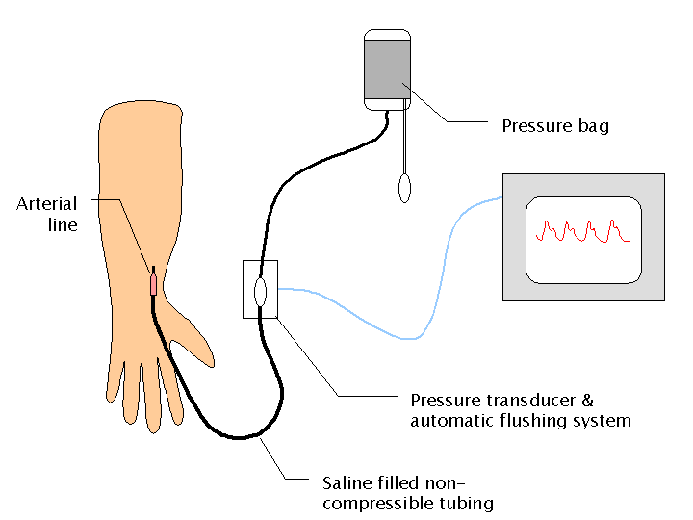
The apparatus
Graphic source: www.aic.cuhk.edu.hk/ web8/
Notes:
Arterial line: placed into an artery
Tubing has known resonance characteristics. Too long and it can resonate more, usually showing increased pulse pressure
transducer is what zero’s measured at. Should normally be placed at the level of the heart (canonical blood pressure)
Bag pressure important: monitor can’t read anything below that pressure (but usually never over 300 mmHg).

Slide 3
Artifact types
Transducer_x000e_ exposed to bag pressure
Transducer open to air
System incorrectly zeroed
Bag underinflated
Line damped improperly

Slide 4
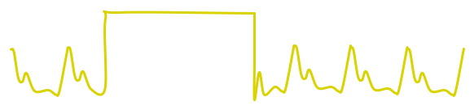
Bag/zero pressure waveform

Slide 5
Bag/zero pressures averaged into 1-minute summaries

Slide 6
Incorrect zero

Slide 7
Incorrect zeroing and underdamping
An under-damped, over-resonant line often exaggerates pulse pressures (though MAPs stay the same)
An incorrect zero causes all readings to be shifted by a constant

Slide 8
A model quantifying these artifacts’ effects in time-averaged data

Slide 9
Is this model any good?
Can it generate realistic-looking events?
Does it react well to real-world data?

Slide 10
Synthetic “blood draw” events

Slide 11
Performance with patient data
Given samples of blood-draw events (from Diane) the formula applied to each blood pressure reading at
“So, does it work well?”

Slide 15
It works—assuming we know …
how BP changes minute to minute
how often to expect blood-draw events
how long they typically last
the bag pressure
that the system is properly zeroed
(so a real model should_x0005_ cover these issues too)

Slide 16
The occurrence model
How to model event start times?
How to model event length?
How many valve events to support per minute?

Slide 17
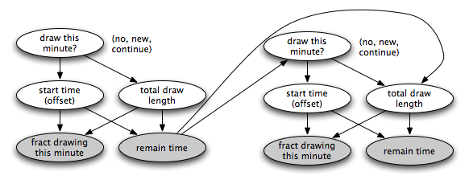
Model 1: exact decisions up front

Slide 18
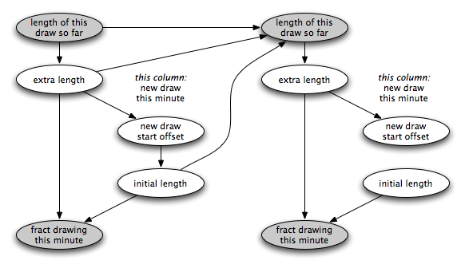
Model 2:

Slide 19
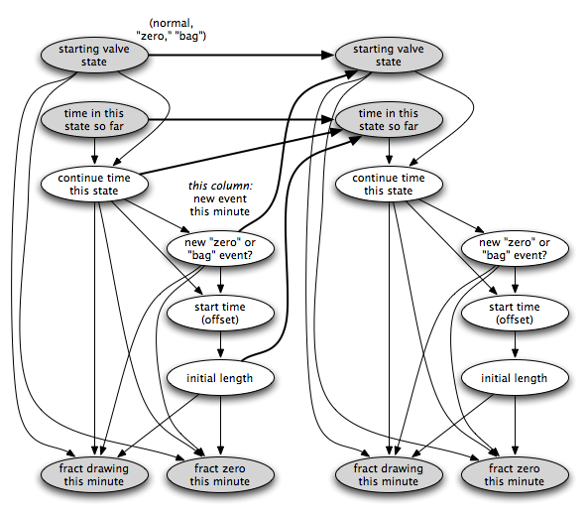
Model 3:

Slide 20
Modeling blood pressure changes
Good coverage requires modeling at least the autonomic nervous system and some drug metabolism, a big job!
In this model, I used a simple random walk.

Slide 21
A basic BP_x0005_ artifact model …

Slide 22
